Slide 1
Gluconeogenesis and the Pentose Phosphate Shunt

Slide 2
Quiz Question #1
What would be the rate of gluconeogenesis be in a type 1 diabetic?
Very high because of a lack of insulin
Very low because of a lack of insulin
Very high because of a lack of insulin responsiveness
Very low because of a lack of insulin responsiveness

Slide 3
Quiz Question #2
Which of the following can suppress glucagon levels
Low blood glucose
High insulin
High somatostatin
All of the above

Slide 4
Quiz Question #3
Transcriptional regulation refers to what?
Increased mRNA production of a particular gene
Increased protein synthesis rates for a particular gene
Enhanced protein phosphorylation of a gene
All of the above

Slide 5
Learning Objectives
Understand the function of the pentose phosphate shunt and why NADPH generation is important.
Describe the key steps by which gluconeogenesis is controlled by protein phosphorylation and by allosteric control.
Explain how transcriptional changes can alter gluconeogenesis in response to insulin and cortisol.
Explain how the cell ensures that gluconeogenesis and glycolysis do not occur simultaneously.
Understand how, in chronic fasting other tissues provide substrates for gluconeogenesis to the liver.

Slide 6
Pentose Phosphate Shunt
Ribose sugars for nucleotides
Important in Rapidly Dividing Cells which need nucleotides
Bone marrow, skin, epithelial cells of GI
NADPH
Needed for FA biosynthesis
Also important in cells that make a lot of lipid
Mainly adipose and liver
NADPH is an Antioxidant
Important for blood cells

Slide 7
Regulation of PPP Entry
First enzyme is the rate limiting and irreversible step
Glucose-6-Phosphate Dehydrogenase
Activated by its two substrates
NADP
Glucose-6-Phosphate
Inhibited by high levels of NADH

Slide 8
Fates of Glucose-6-Phosphate
Glycogenesis
Pentose Phosphate Pathway
GS
Glucose-6-Phosphate
Insulin/Glucagon
PFK1
Citrate
AMP/ATP
F26BP
Insulin/Glucagon
G6PDH
NADP/NADPH
Glucose-6-Phosphate

Slide 9
We know a lot about this
What mechanisms have we discussed that will tilt the balance towards glucose production and release from the liver cell

Slide 10
Gluconeogenesis
Cahill Cycle
Cori Cycle
Uses ~2ATP
During exercise
During Amino Acid Breakdown
Notes:
Why alanine

Slide 11
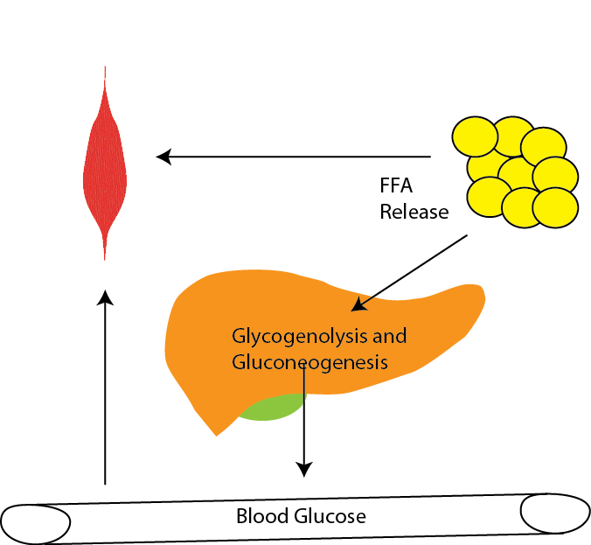
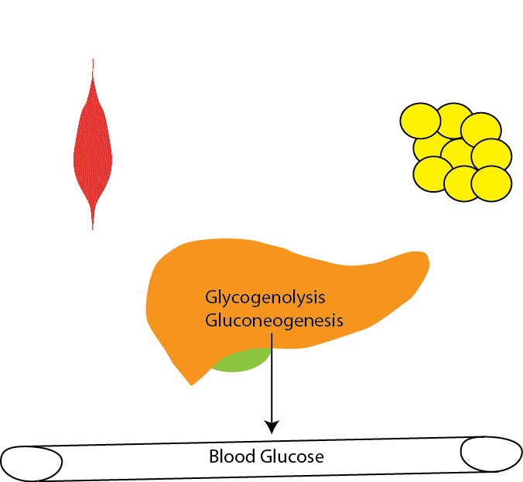
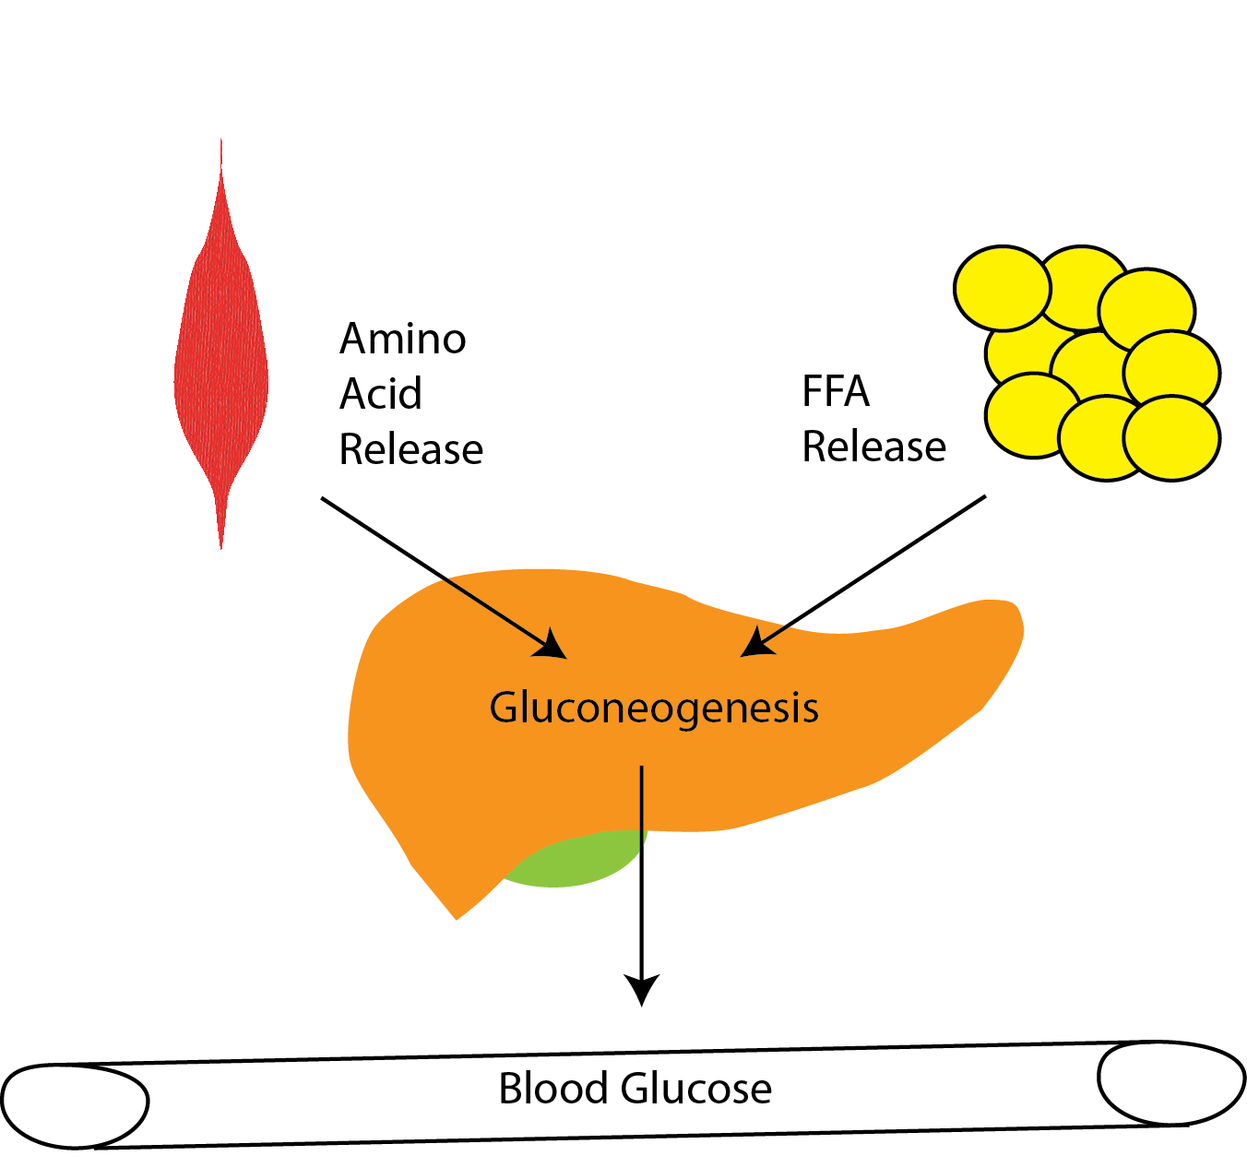
Gluconeogenesis Can Be Activated by Hormones
Adrenaline
Glucagon
Cortisol
What are the physiological reasons these hormones have different actions on fat and muscle different tissues ?

Slide 12
Autophagy and the Fasting Response
Yoshinori Ohsumi
2016 Nobel Prize in Physiology or Medicine

Slide 13
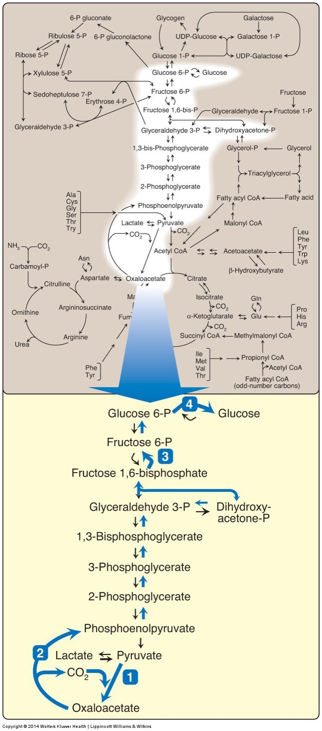
The gluconeogenic pathway
Very similar to glycolysis
Three big differences
Glucose-6-Phosphatase instead of reversed Glucokinase
Fructose 1,6 Bisphosphatase instead of reversed PFK1
OAA -> Pyruvate (skips pyruvate kinase)
Glycolysis was PEP -> Pyruvate

Slide 14
Regulation of Gluconeogensis
TCA Cycle

Slide 15
Phosphoenolpyruvate Carboxykinase
First committed and rate limiting step
PEPCK not regulated allosterically
Insulin regulates transcriptionally (will discuss later)

Slide 16
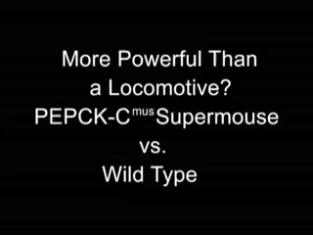
Muscle PEPCK Mouse
A transgenic mouse that overexpresses PEPCK has been dubbed the ”supermouse”
7-10x more active
Can run very very long distances (20m/min for 6h)
Many more mitochondria
Very efficient at using lipid as fuel for exercise
Why do you think this is the case?

Slide 17
Pyruvate Carboxylase
Can replenish oxaloacetate, bypassing TCA cycle
Is this step:
Anaplerotic
Cataplerotic
Activated by acetyl-CoA
Important for conversion of both Alanine and Lactate back into glucose

Slide 18
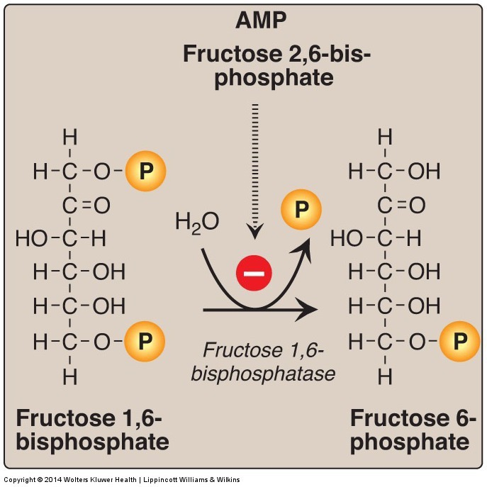
Fructose bisphosphatase 1 reverses PFK1
Inhibited by
F26BP
AMP

Slide 19
What activates PFK1?
Citrate
AMP
ATP
Glucagon

Slide 20
Effects of Fructose 2,6 bisphosphate on PFK1/FBPase
PFK1 Activity
FBPase Activity

Slide 21
Regulation by Glucagon/Epinephrine
Talk about how gluconeogenesis and glycolysis will be changed when glucagon inactivates phosphofructokinase-2 (PFK2) in the liver
What about in the muscle?

Slide 22
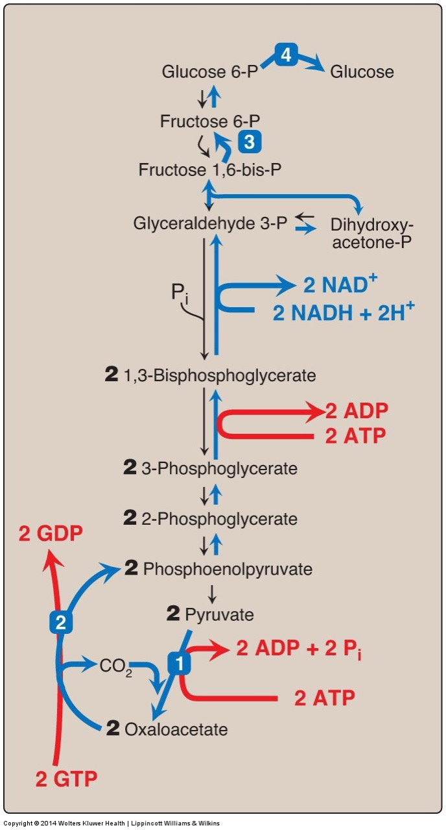
Gluconeogenesis is Expensive
Glycolysis +8 ATP
Glycolysis, Pyruvate Oxidation, ETC +36 ATP
Gluconeogenesis -12 ATP
-6 ATP
-2 NADH (x3 = -6 ATP)
Notes:
Glycolysis followed by gluconeoegenesis is net energy costly, therefore never want both at the same time

Slide 23
Co-ordinate control of gluconeogenesis and glycolysis
 | Glycolysis | Gluconeogenesis
Activity of Glucokinase | High (Glucose High) | Low (Glucose Low)
Activity of Glucose-6-Phosphatase | Low (Transcriptional) | High (Transcriptional)
Activity of Phosphofructokinase | High (via F26BP high/AMP) | Low (via F26BP low/ATP/Citrate)
Phosphorylation of PFK2 | Dephosphorylated (Active) | Phosphorylated (Inactive)
Activity of FBPase | Low (via F26BP high/AMP/Citrate) | High (via F26BP low)
Phosphorylation of Pyruvate Kinase | Dephosphorylated (Active) | Phosphorylated (Inactive)
Activity of Pyruvate Kinase | High (AMP/F16BP) | Low (Alanine)
Activity of Pyruvate Carboxylase | Low | High (Acetyl-CoA)
Activity of PEPCK | Low (Transcriptional) | High (Transcriptional)

Slide 24
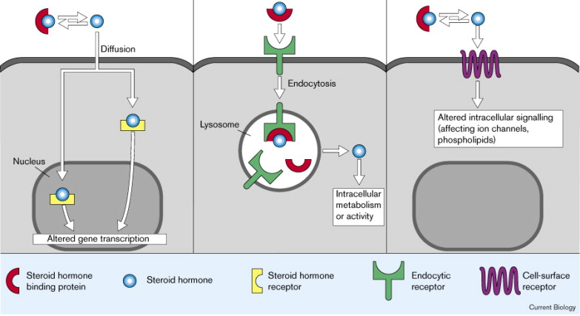
Nuclear Hormone Receptors
Insulin
Glucagon
Epinephrine
Cortisol

Slide 25
Why would transcriptional alterations be preferable?
Faster
More permanent
More easily reversible
Energetically efficient

Slide 26
Cortisol Effects on Gluconeogenesis
Transactivates (increases protein levels)
G6Pase
PEPCK
Notes:
This is unsatisfyingly compelling

Slide 27
Insulin Effects on Gluconeogenesis
Thought to be mainly transcriptional (via a transcription factor FOXO)
Induces the expression of
Glucokinase
Represses
Glucose-6-Phosphatase
PEPCK
Promotes the dephosphorylation of PFK2 and Pyruvate Kinase
What would that do?
Indirectly
Promotes glycogenesis, diverting G6P away from making glucose
Prevents fatty acid and amino acid release from fat and muscle

Slide 28
Insulin Resistance and Diabetes
Glucose Production
These graphs are fasting glucose vs the indicated
Solid dots (on the right) are diabetics
Open dots are non-diabetics
Glucose Oxidation
Bogardus C, Lillioja S, Howard B V, Reaven G, Mott D. Relationships between insulin secretion, insulin action, and fasting plasma glucose concentration in nondiabetic and noninsulin-dependent diabetic subjects. J. Clin. Invest. 1984;74(4):1238–1246.
Lipid Oxidation

Slide 29
Learning Objectives
Understand the function of the pentose phosphate shunt and why NADPH generation is important.
Describe the key steps by which gluconeogenesis is controlled by protein phosphorylation and by allosteric control.
Explain how transcriptional changes can alter gluconeogenesis in response to insulin and cortisol.
Explain how the cell ensures that gluconeogenesis and glycolysis do not occur simultaneously.
Understand how, in chronic fasting other tissues provide substrates for gluconeogenesis to the liver.

